Slide 1

23CSE461
NATURAL LANGUAGE PROCESSING
Case study Review 1
Professor – T Senthil Kumar ( CSE)

Slide 2


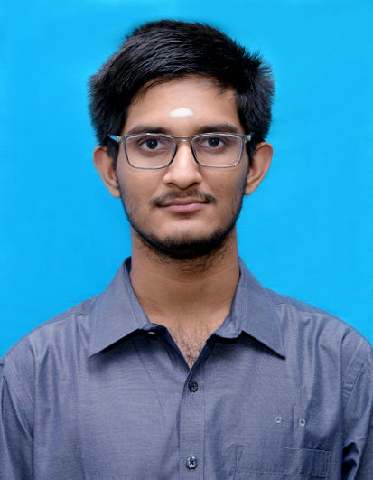

LEGAL DOCUMENT SUMMARIZER
TEAM NUMBER - 4
NAME | ROLL NUMBER | GITHUB URL | COLLEGE MAIL ID | MOBILE NUMBER
Akula Manideep Reddy | CB.SC.U4CSE24462 | https://github.com/MANIDEEP2407-SYS | cb.sc.u4cse24462@cb.students.amrita.edu | 9888561561
Mahima R Iyer | CB.SC.U4CSE24732 | https://github.com/mahima1006 | cb.sc.u4cse24732@cb.students.amrita.edu | 9994282145
Samanyu Nair | CB.SC.U4CSE24745 | https://github.com/SamanyuNair | cb.sc.u4cse24745@cb.students.amrita.edu | 9539544726
Sivasubramani K J | CB.SC.U4CSE24752 | Phyboc (https://github.com/Phyboc) | cb.sc.u4cse24752@cb.students.amrita.edu | 9445819683
MAHIMA R IYER
SAMANYU NAIR
SIVASUBRAMANI K J
AKULA MANIDEEP REDDY

Slide 3
COLLABORATOR DETAILS:
Collaborator Category | Role & Expertise | Specific Responsibility in Campus Bites
Technical Team | Model Lead (AI / ML Engineer, NLP) (Sivasubramani K J) | Fine-tuning the BART-base model on the IN-Abs dataset, managing hyperparameter loops, and handling GPU compute execution.
 | Data & Pruning Lead (Data Engineer, Algorithms) (Mahima R Iyer) | PDF text extraction, implementing TextRank/LexRank for algorithmic length pruning, and handling PII redaction logic.
 | Explainability Lead (NLP Logic, Post-Processing) (Akula Manideep Reddy) | Developing the Cross-Encoder for the "Cite & Verify" attribution mapping and building the custom Latin-to-plain-English jargon dictionary.
 | Integration Lead (DevOps, UI, Evaluation) (Samanyu Nair) | Assembly of the final pipeline, building the Click/Rich CLI and Gradio web interface, and running ROUGE/BERTScore benchmarking.

Slide 4
Abstract:
Context: The Indian judicial system faces a severe backlog of over 51 million pending cases, largely due to the time-intensive process of manual legal research and analysis of lengthy, complex documents. Legal texts pose significant challenges for Natural Language Processing (NLP) because of their intricate structure, domain-specific language, and the need for factually accurate, coherent summaries. Existing summarization approaches struggle with long documents, hallucinations, and accessibility for non-legal users. To address these issues, this project proposes a novel legal document summarization system that simplifies and democratizes access to legal information, supporting SDG 16 (Peace, Justice, and Strong Institutions), particularly Target 16.3, by promoting equal access to justice and bridging the gap between the judiciary and the public.
Approach: This project introduces a robust three-stage pipeline for summarizing lengthy Indian Supreme Court judgments. First, an intelligent document pruning stage uses extractive summarization techniques such as TextRank or LexRank to reduce document length by over 70%, enabling efficient processing of long legal texts. The pruned content is then passed to a fine-tuned NLP model trained on the IN-Abs dataset to generate fluent and accurate abstractive summaries. Finally, a post-processing stage enhances reliability and accessibility by mapping each summary sentence to its corresponding source paragraph with confidence scores to minimize AI hallucinations and provide verifiable citations, while also simplifying complex legal jargon into plain language, making the summaries easier for non-legal users to understand.
Benchmark: The proposed system will be evaluated using both automatic metrics and human assessments to ensure accuracy and practical usefulness. The IN-Abs dataset will serve as the primary benchmark for fine-tuning and evaluation. Performance will be measured using ROUGE-1, ROUGE-2, and ROUGE-L F1 scores, which assess n-gram overlap with reference summaries, and BERTScore, which evaluates semantic similarity using contextual embeddings to better capture meaning. Additionally, a qualitative human evaluation will be conducted on a random sample of generated summaries, where participants will assess relevance, coherence, and factual consistency, providing valuable insights into the system's reliability, trustworthiness, and real-world applicability.

